Slide 1

Annual Conference of
Interreg VI-A Romania-Bulgaria Programme
30th of October 2025
Shabla, Bulgaria

Slide 2
1990
a small Community Initiative
2025
A Cohesion Policy instrument, with over €40 billion invested in more than 30,000 projects involving over 135,000 partners
A Symbol of EU Solidarity
Over the years, Interreg has built bridges—both literal and metaphorical—between regions, communities and institutions.

Slide 3

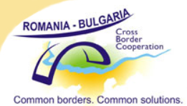

Phare CBC RoBg 2004, 2005 and 2006
CBC RoBg 2007-2013 Programme
Interreg V-A RoBg Programme 2014-2020
Interreg VI-A RoBg Programme 2021-2027
135 projects
24,6 mil euro
179 projects
262 mil euro
169 projects
258 mil euro
32 projects
61,7 mil euro and still counting...

Slide 4
Removing Barriers: Facilitating border crossing, harmonizing public services (health, transport) and developing mutual trust.
Improved Services: Joint projects in health, education, cross-border public transport.
Cultural and Tourism Development: Promoting common cultural heritage and developing common tourist routes.
Increasing Cohesion: Strengthening the sense of belonging to a common European community, especially among citizens living in border areas.

Slide 5
MAIN OBJECTIVES
A smarter Europe: Through innovation, digitalisation and competitiveness.
A greener Europe: Through the transition to low-carbon energy and climate resilience.
A more connected Europe: Through improving mobility and ICT connectivity.
A more social and inclusive Europe: Through education, health and employment.
A Europe closer to citizens: Supporting local strategies.
Better governance of cooperation: Increasing the institutional capacity of public administrations.
A safer and more secure Europe: For actions in the fields of border crossing management, mobility and migration management.

Slide 6
Examples of tangible results across Europe:
Construction/rehabilitation of cross-border roads.
Creation of common emergency networks (fire brigades, ambulances) and cross-border hospitals.
Development of common strategies for flood and fire management, waste management or biodiversity protection.
Countless educational and cultural institutions that have developed their material base, contributing to the development of education.
Thousands of NGOs supported to cooperate across borders.
Numerous regional action plans adopted, based on the exchange of good practices.

Slide 7

Programme priorities
Priority 1: A well connected region
Priority budget for projects: 20 mil euro ERDF
Specific Objective 3.2
Developing and enhancing sustainable, climate resilience, intelligent and intermodal national, regional and local mobility, including improved access to TEN-T and cross border mobility
Actions improving the navigation conditions and safety on the Danube and Black Sea in order to enhance the mobility and connectivity in the cross-border area
1 contracted project – approx.10 mil euro ERDF

Slide 8


Programme priorities
Priority 2: A green region
Priority budget for projects: 68.8 mil euro ERDF
Specific Objective 2.4
Promoting climate change adaptation and disaster risk prevention, resilience, taking into account ecosystem-based approaches
Specific Objective 2.7
Enhancing protection and preservation of nature, biodiversity and green infrastructure, including in urban areas, and reducing all forms of pollution
11 contracted projects – approx. 39 mil euro ERDF

Slide 9


Programme priorities
Priority 3: An educated region
Priority budget for projects : 12 mil euro ERDF
Specific objective 4.2
Improving equal access to inclusive and quality services in education, training and lifelong learning through developing accessible infrastructure, including by fostering resilience for distance and on-line education and training
Supporting joint actions aimed at lowering the discrepancies in the area, and facilitating the development of the cross-border cooperation between the two sites of the border.
20 contracted projects – approx.12.2 mil euro ERDF

Slide 10

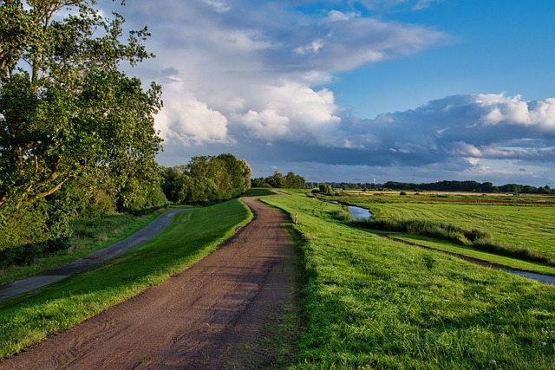
Programme priorities
Priority 4: An integrated region
Priority budget for projects: 52 mil euro ERDF
Specific objective 5.2
Fostering the integrated and inclusive social, economic and environmental local development, culture, natural heritage, sustainable tourism and security, in areas other than urban areas
1. Developing the Eurovelo 6 cycling route
2. Supporting tourism activities, connected
sectors and industries
3. Support for implementing the integrated
territorial strategy

Slide 11
32 contracted projects – value of approx. 61.7 mil euro ERDF
4th call for the operations under PO 2 (SO 2.4) – 7.3 mil euro ERDF – under selection process
5th call for the operation under PO 2 (S.O. 2.7) – 8.2 mil euro ERDF – under evaluation process
6th call dedicated to the operations of strategic importance addressing the navigability and rail infrastructure, under PO1 – 10 mil euro ERDF – on going, submission deadline, 22nd December, 2025

Slide 12
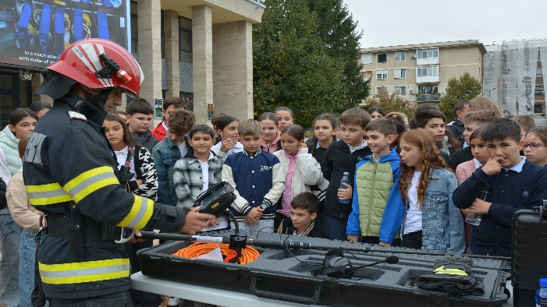
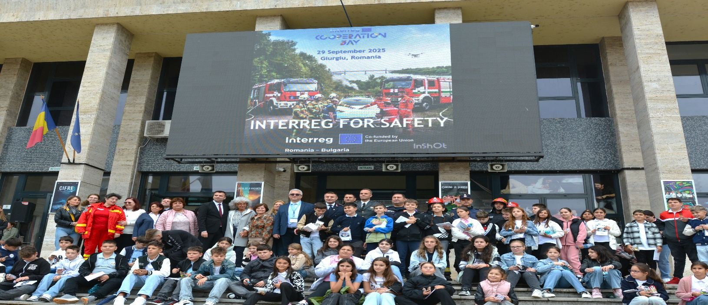
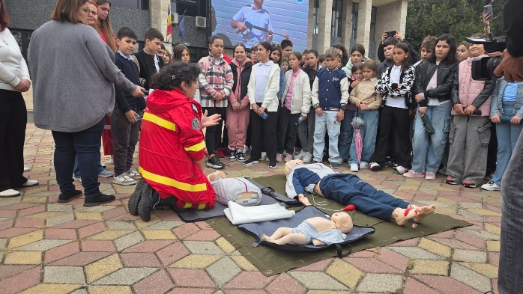
Communication activities in 2025
Events
9th of May 2025- celebrating Europe’s Day at Art Gallery “Hristo Denev” Veliko Tarnovo
29th of September, Giurgiu – celebrating Interreg Cooperation Day 2025 – Interreg for safety!
30th of October 2025, Shabla - the Annual Conference of the Programme

Slide 13
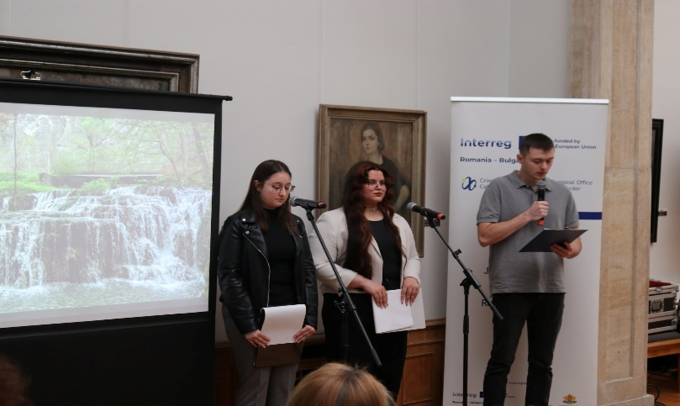
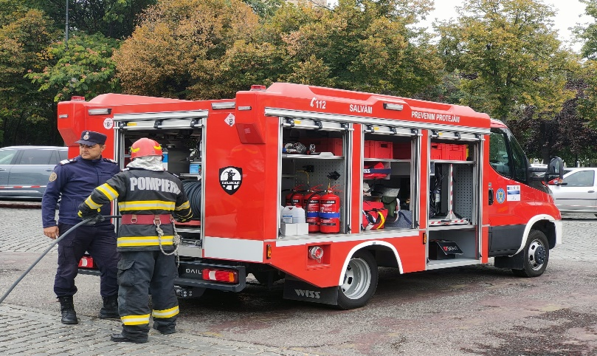
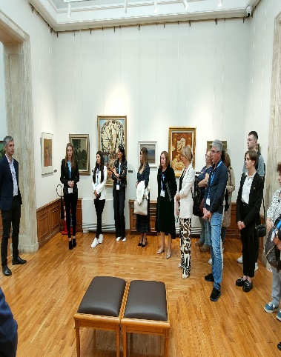
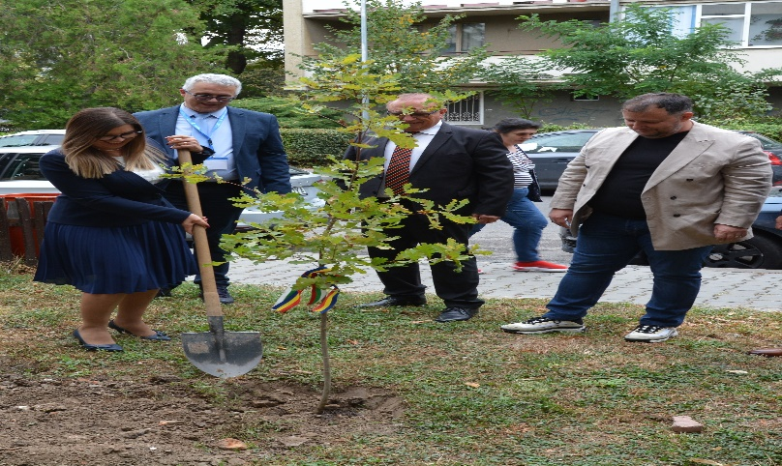
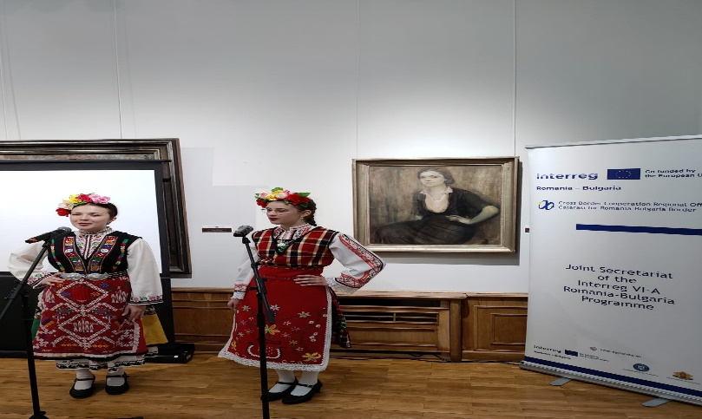
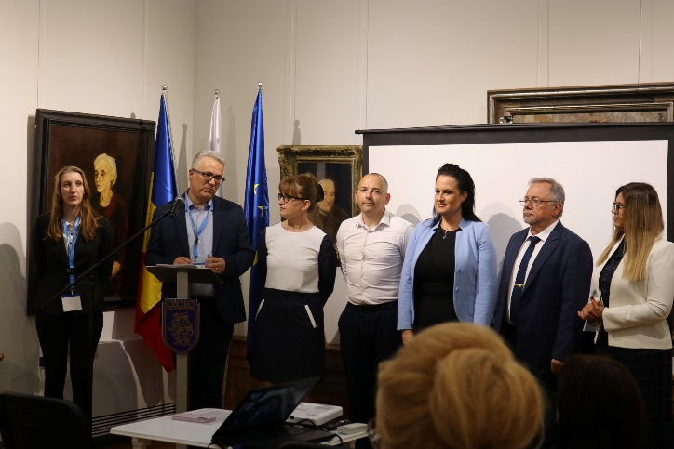
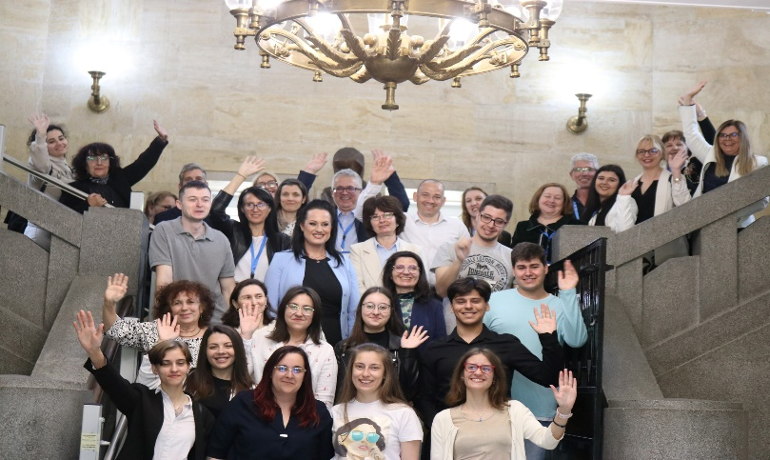

Slide 14
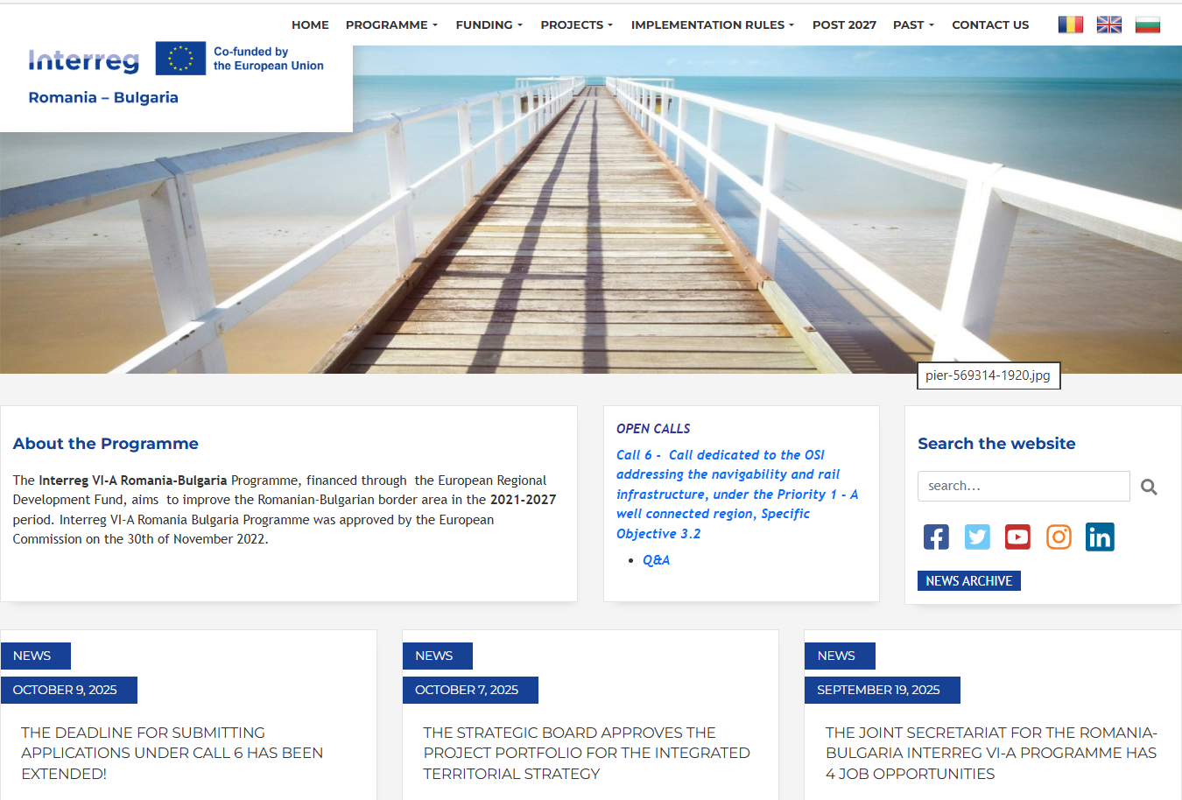

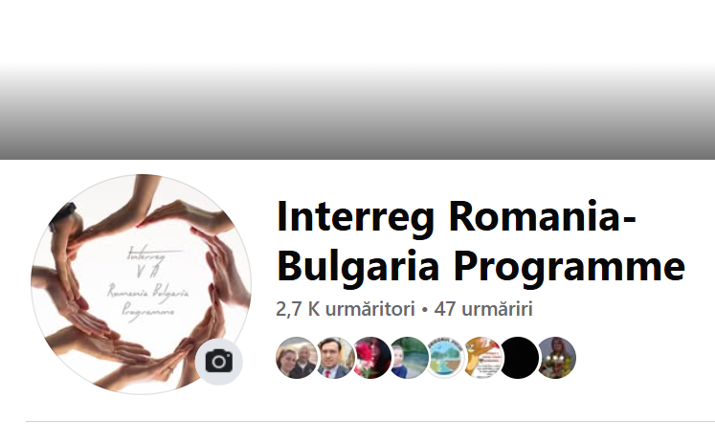
Communication activities in 2025
Updating the Programme website
Keeping the FB page updated

Slide 15
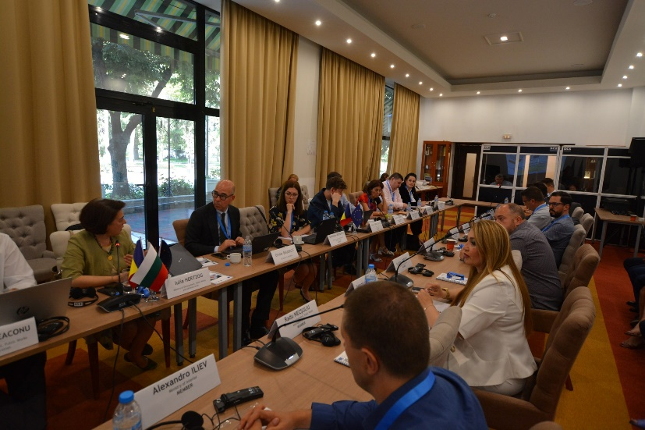
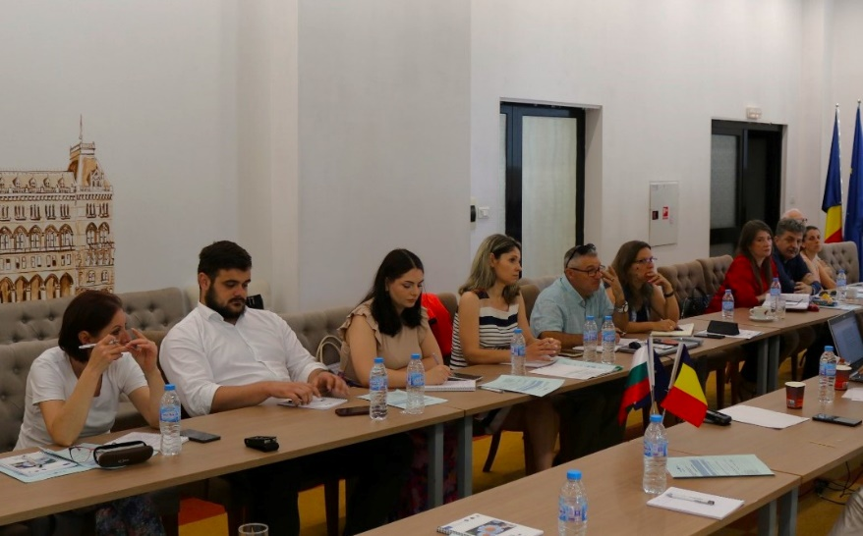
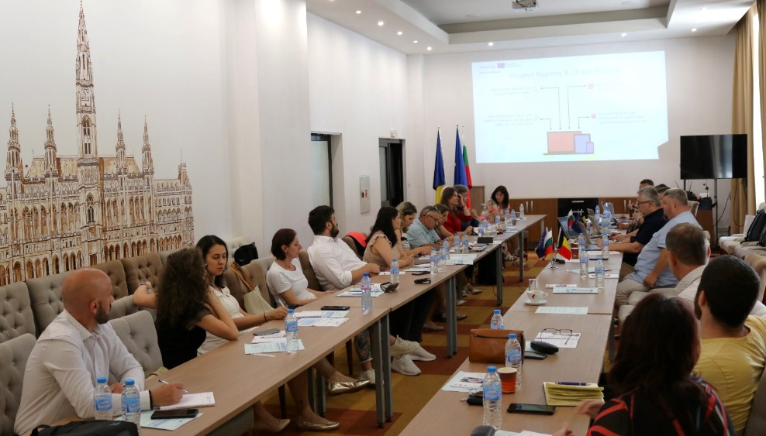
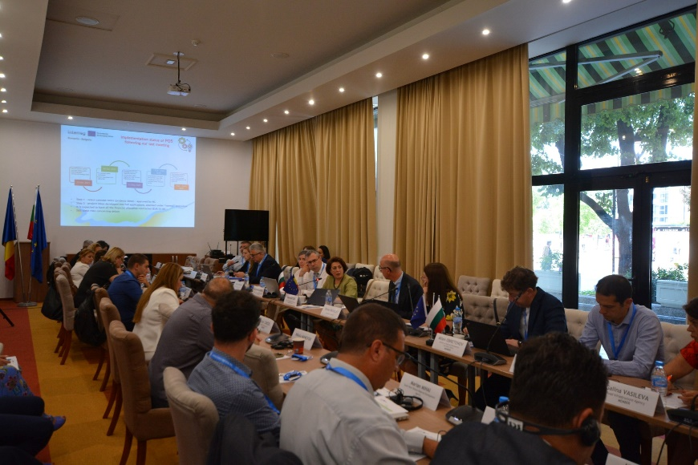
Events dedicated to potential applicants
2 Events dedicated to the presentation of the eligibility conditions, the application and a partner search section for Call 4, Priority 2, Specific Objective 2.4
2 Events dedicated to the presentation of the eligibility conditions, the application and a partner search section for Call 5, Priority 2, Specific Objective 2.7
6 Sessions for preparing the application for Call 6, Priority 1, Specific Objective 3.2
Every Thursday during the calls, individual online sessions

Slide 16
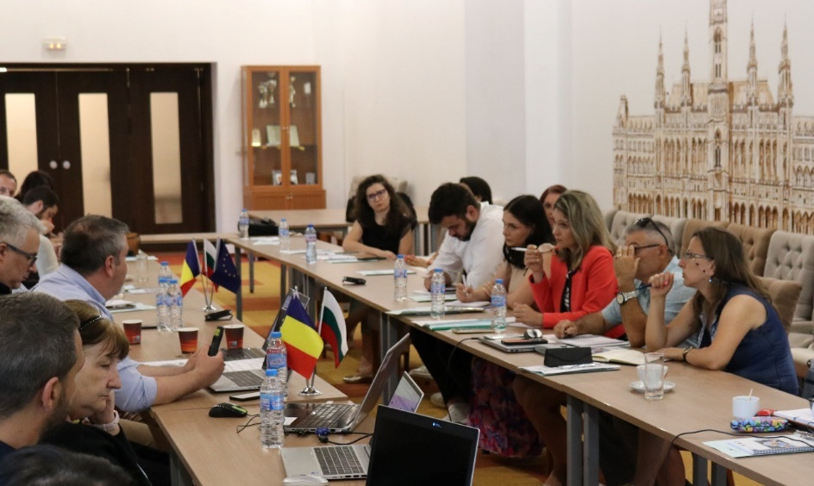
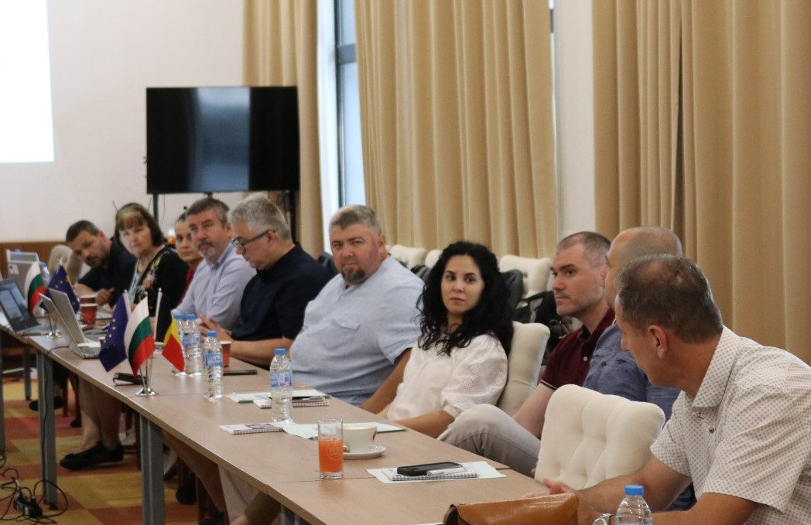
Event dedicated to beneficiaries Ruse - 18.06.2025

Slide 17
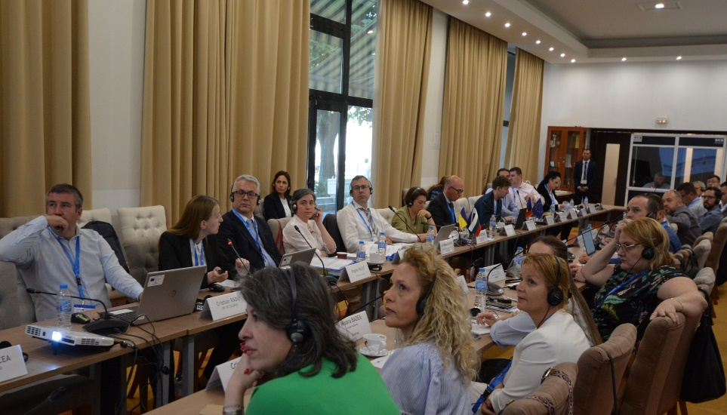
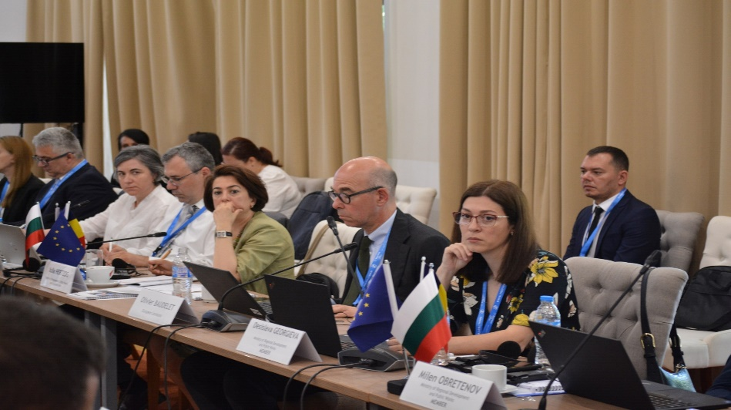
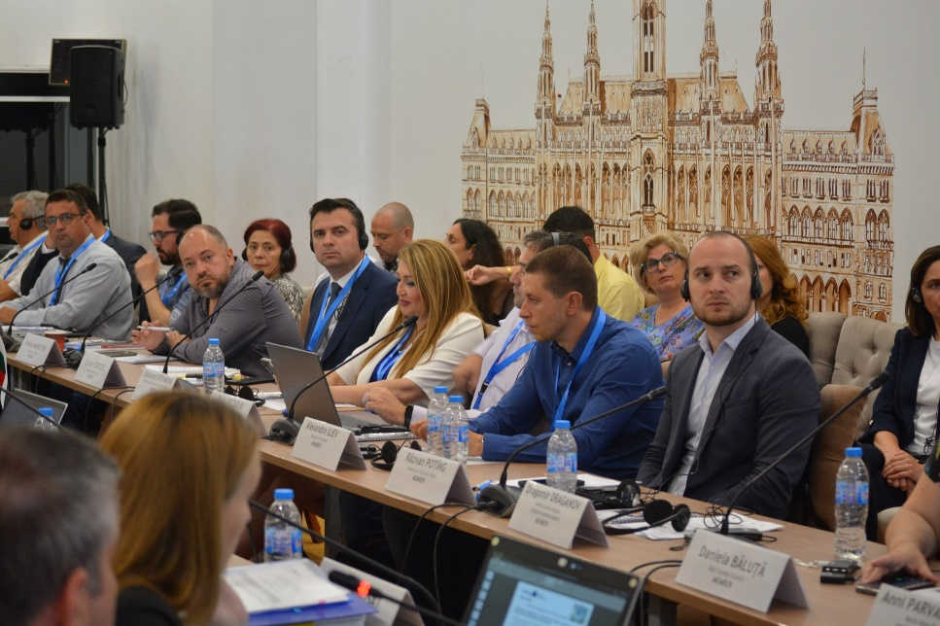
Monitoring Committee meeting Ruse – 17.06.2025

Slide 18

https://interregviarobg.eu/

