Slide 1


Annual Conference of the of
Interreg VI-A Romania-Bulgaria Programme
31st of October 2024
Piatra Olt, Romania

Slide 2

Programme priorities
Priority 1: A well connected region
Priority budget: 27.15 mil euro (21.40 mil euro ERDF)
Allocation available for projects: 25 mil euro (20 mil euro ERDF)
Specific Objective 3.2
Developing and enhancing sustainable, climate resilience, intelligent and intermodal national, regional and local mobility, including improved access to TEN-T and cross border mobility
Actions improving the navigation conditions and safety on the Danube and Black Sea in order to enhance the mobility and connectivity in the cross-border area

Slide 3


Programme priorities
Priority 2: A green region
Priority budget: 93.40 mil euro (73.61 mil euro ERDF)
Allocation available for projects: 86 mil euro (68.8 mil euro ERDF)
Specific Objective 2.4
Promoting climate change adaptation and disaster risk prevention, resilience, taking into account ecosystem-based approaches
Specific Objective 2.7
Enhancing protection and preservation of nature, biodiversity and green infrastructure, including in urban areas, and reducing all forms of pollution

Slide 4


Programme priorities
Priority 3: An educated region
Priority budget: 16.29 mil euro (12.84 mil euro ERDF)
Allocation available for projects: 15 mil euro (12 mil euro ERDF)
Specific objective 4.2
Improving equal access to inclusive and quality services in education, training and lifelong learning through developing accessible infrastructure, including by fostering resilience for distance and on-line education and training
Supporting joint actions aimed at lowering the discrepancies in the area, and facilitating the development of the cross-border cooperation between the two sites of the border.

Slide 5

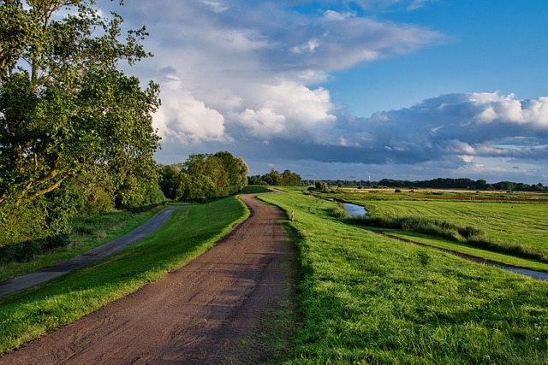
Programme priorities
Priority 4: An integrated region
Priority budget: 70.60 mil euro (55.64 mil euro ERDF)
Allocation available for projects: 65 mil euro (52 mil euro ERDF)
Specific objective 5.2
Fostering the integrated and inclusive social, economic and environmental local development, culture, natural heritage, sustainable tourism and security, in areas other than urban areas
1. Developing the Eurovelo 6 cycling route
2. Supporting tourism activities, connected
sectors and industries
3. Support for implementing the integrated
territorial strategy

Slide 6
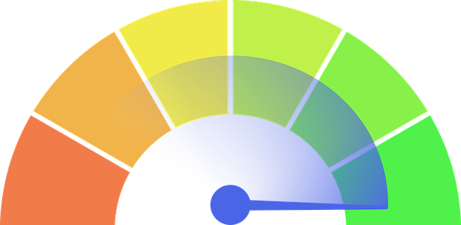
What happened up to date?
1st call for the operations of strategic importance (OSI)
Implementing DISMAR Project, 10 mil. Euro
Approving the selection for financing of project STREAM 2, 24,3 mil. Euro
Under verification of the assessment process Danube Risk, 17,5 mil. Euro
2nd call for the operations under PO 2 (SO 2.4 + SO 2.7)
Implementing 2 projects with a total value of 6 mil. Euro
Approving the selection for financing of 8 projects with a total value of 18,66 mil. euro
3rd call for the operations under PO 4 (SO 4.2)
4th call for the operations under PO 2 (SO 2.4)
Support to applicants: workshops, webinars, individual sessions, helpdesk

Slide 7
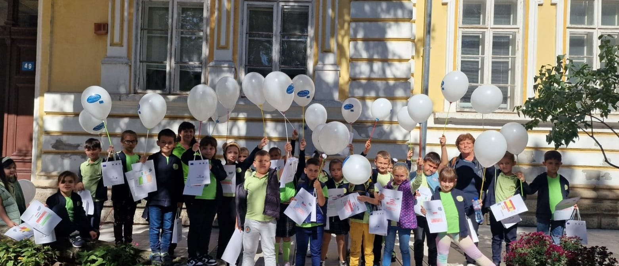
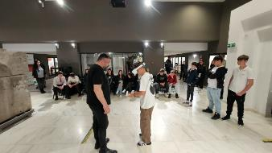
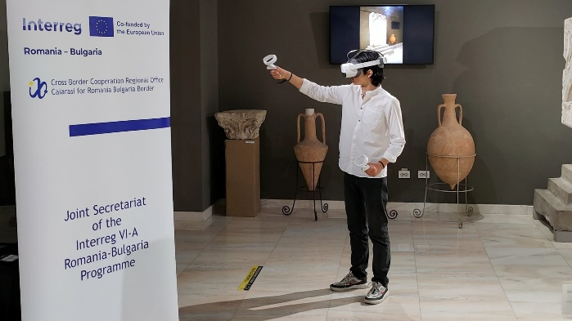
Communication activities in 2024
Events
9th of May 2024- celebrating Europe’s Day at Lower Danube Museum in Călărași
3rd October 2024, Călărași and Silistra – celebrating Interreg Cooperation Day 2024 – We recycle, play and make new friends!
31st October 2024, Piatra Olt (Romania)- the Annual Conference of the Programme

Slide 8

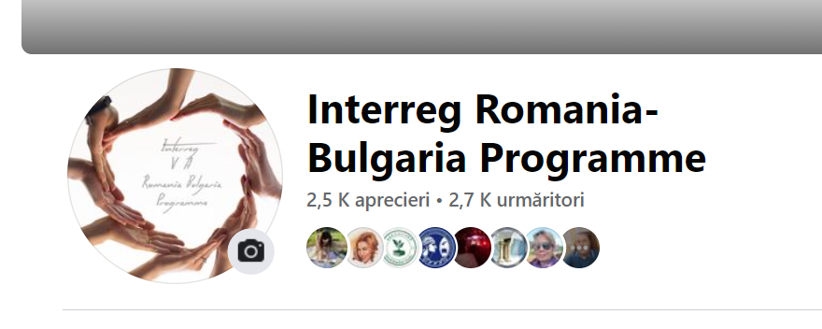
Communication activities in 2024
Facebook campaigns
FB campaign for promoting the achievements of projects financed by Interreg V-A RO-BG Programme
FB campaign for presenting inspiring examples of projects on education, dedicated to potential applicants #GetInspiredbySuccessfulProjects (June-August 2024)

Slide 9
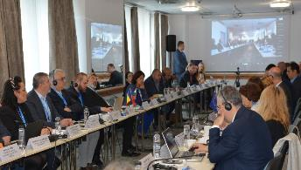
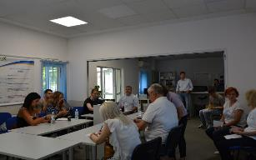
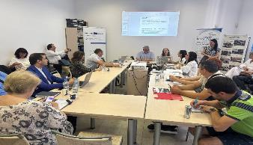
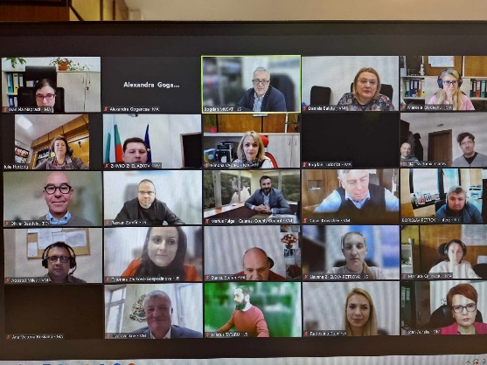
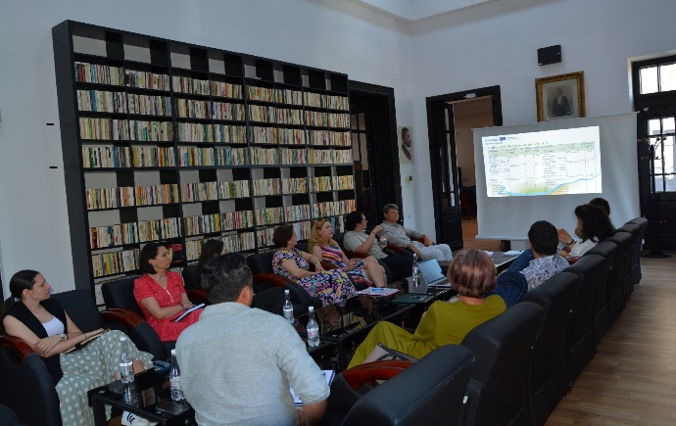
Events dedicated to potential applicants
Webinars – presentations of general information on the Applicant’s Guide followed by a Q&A session
Webinars dedicated to the Jems Electronic system followed by a Q&A session
Events dedicated to the presentation of the eligibility conditions, the application and a partner search section,
Partner search online forums
Webinars Q&A, discussions on general topics
Every Thursday during the calls, individual online sessions

Slide 10

Preparing for the future post 2027
Online public consultation launched in April 2024 on the programme website:
for citizens: https://ec.europa.eu/eusurvey/runner/InterregROBGConsultationpost2027_EN_CTZ?fbclid=IwY2xjawFiGyNleHRuA2FlbQIxMAABHR1QZEwxqFvMgEWGgbnkjc5PDMzG7br1r-0k_CzH_F1OC_MY8vBRKMReXQ_aem__toqgdjkdWkWx2tCyzNduQ
for stakeholders:
https://ec.europa.eu/eusurvey/runner/InterregROBGConsultationpost2027_EN_STK?fbclid=IwY2xjawFiG2xleHRuA2FlbQIxMAABHUFyN87H3Jbh-xN7FBg-wBFpaqyIo6qDYdT6EjVin8YXyNwfvcAL01uRtQ_aem_u9UwyNcRunlZLIUtsawI2A
Post 2027 consultation events
21st of May 2024- first consultation session with students from University of Craiova
22nd of October 2024- second consultation session with students from University of Ruse
25th of October 2024- third consultation session with students from University of Constanța

Slide 11
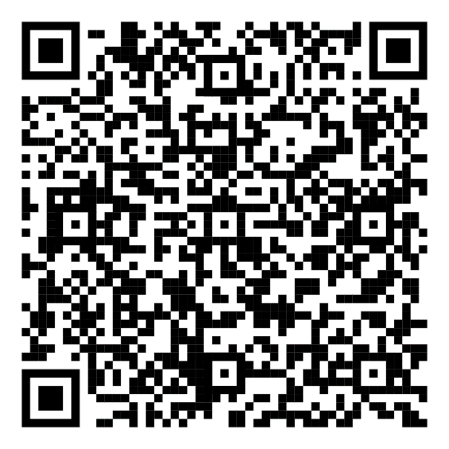
Preparing for the future post 2027
Please take a few minutes of your time and fill in the online questionnaire here:
Thank you!

Slide 12

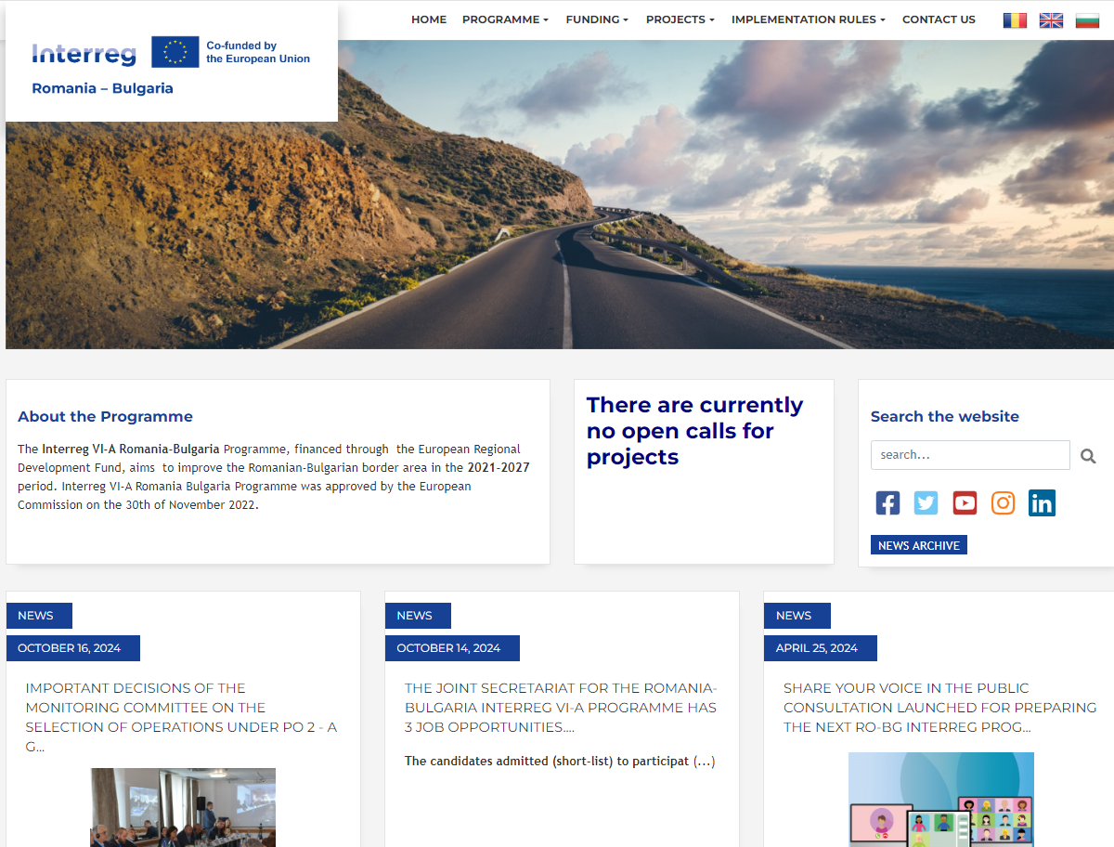
https://interregviarobg.eu/

